Slide 1
Satisfiability and entailment
A sentence is satisfiable if it is true in at least one world
Suppose we have a hyper-efficient SAT solver (WARNING: NP-COMPLETE 👿 👿 👿); how can we use it to test entailment?
α |= β
iff α ⇒ β is true in all worlds
iff ¬(α ⇒ β) is false in all worlds
iff α ∧ ¬β is false in all worlds, i.e., unsatisfiable
So, add the negated conclusion to what you know, test for (un)satisfiability; also known as reductio ad absurdum
Efficient SAT solvers operate on conjunctive normal form

Slide 2
Conjunctive normal form (CNF)
Replace biconditional by two implications
Every sentence can be expressed as a conjunction of clauses
Each clause is a disjunction of literals
Each literal is a symbol or a negated symbol
Conversion to CNF by a sequence of standard transformations:
At_1,1_0 ⇒ (Wall_0,1 ⇔ Blocked_W_0)
At_1,1_0 ⇒ ((Wall_0,1 ⇒ Blocked_W_0) ∧ (Blocked_W_0 ⇒Wall_0,1))
¬At_1,1_0 v ((¬Wall_0,1 v Blocked_W_0) ∧ (¬Blocked_W_0 v Wall_0,1))
(¬At_1,1_0 v ¬Wall_0,1 v Blocked_W_0) ∧
(¬At_1,1_0 v ¬Blocked_W_0 v Wall_0,1)
Replace α ⇒ β by ¬α v β
Distribute v over ∧

Slide 3
Efficient SAT solvers
DPLL (Davis-Putnam-Logemann-Loveland) is the core of modern solvers
Recursive depth-first search over models with some extras:
Early termination: stop if
all clauses are satisfied; e.g., (A ∨ B) ∧ (A ∨ ¬C) is satisfied by {A=true}
any clause is falsified; e.g., (A ∨ B) ∧ (A ∨ ¬C) is falsified by {A=false,B=false}
Pure literals: if all occurrences of a symbol in as-yet-unsatisfied clauses have the same sign, then give the symbol that value
E.g., A is pure and positive in (A ∨ B) ∧ (A ∨ ¬C) ∧ (C ∨ ¬B) so set it to true
Unit clauses: if a clause is left with a single literal, set symbol to satisfy clause
E.g., if A=false, (A ∨ B) ∧ (A ∨ ¬C) becomes (false ∨ B) ∧ (false ∨ ¬C), i.e. (B) ∧ (¬C)
Satisfying the unit clauses often leads to further propagation, new unit clauses, etc.

Slide 4
DPLL algorithm
function DPLL(clauses,symbols,model) returns true or false
if every clause in clauses is true in model then return true if some clause in clauses is false in model then return false P,value ←FIND-PURE-SYMBOL(symbols,clauses,model) if P is non-null then return DPLL(clauses, symbols–P, model∪{P=value})
P,value ←FIND-UNIT-CLAUSE(clauses,model) if P is non-null then return DPLL(clauses, symbols–P, model∪{P=value})
P ← First(symbols); rest ← Rest(symbols) return or(DPLL(clauses,rest,model∪{P=true}),
DPLL(clauses,rest,model∪{P=false}))

Slide 5
Efficiency
Naïve implementation of DPLL: solve ~100 variables
Extras:
Smart variable and value ordering
E.g., choose values first for variables that appear in lots of clauses
Divide and conquer
If any set of clauses shares no variables with the other clauses, solve it separately
Caching unsolvable subcases as extra clauses to avoid redoing them
Cool indexing and incremental recomputation tricks so that every step of the DPLL algorithm is efficient (typically O(1))
Index of clauses in which each variable appears +ve/-ve
Keep track number of satisfied clauses, update when variables assigned
Keep track of number of remaining literals in each clause
Real implementation of DPLL: solve ~100000000 variables

Slide 6
SAT solvers in practice
Circuit verification: does this VLSI circuit compute the right answer?
Software verification: does this program compute the right answer?
Software synthesis: what program computes the right answer?
Protocol verification: can this security protocol be broken?
Protocol synthesis: what protocol is secure for this task?
Lots of combinatorial problems: what is the solution?
Planning: how can I eat all the dots???

Slide 7
Summary
Inference in propositional logic:
Inference algorithms determine whether α |= β
Theorem provers apply inference rules to construct proofs
Model checkers enumerate models to establish entailment directly
Forward chaining is sound, complete, and linear-time for definite clauses
DPLL enumerates possible models via recursive depth-first search
Even though propositional logic KBs are often very large, modern SAT solvers (usually based on DPLL) are usually very efficient in practice

Slide 8



CSC 2114: Artificial Intelligence
Logical Agents
Notes:
Please retain proper attribution and the reference to ai.berkeley.edu. Thanks!

Slide 9
A knowledge-based agent
function KB-AGENT(percept) returns an action
persistent: KB, a knowledge base
t, an integer, initially 0
TELL(KB, MAKE-PERCEPT-SENTENCE(percept, t))
action ← ASK(KB, MAKE-ACTION-QUERY(t))
TELL(KB, MAKE-ACTION-SENTENCE(action, t))
t←t+1
return action

Slide 10
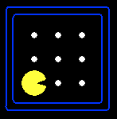
Reminder: Partially observable Pacman
Pacman perceives wall/no-wall in each direction
Variables:
Wall_0,0, Wall_0,1, …
Blocked_W_0, Blocked_N_0, …, Blocked_W_1, …
W_0 , N_0, …, W_1, …
At_0,0_0 , At_0,1_0, …, At_0,0_1 , …

Slide 11
Pacman’s knowledge base: Basic PacPhysics
Map: where the walls are and aren’t
Initial state: Pacman is definitely somewhere
Domain constraints:
Pacman does exactly one action at each step
Pacman is in exactly one location at each step
Sensor model: <Percept_t> ⇔ <some condition on world_t>
Transition model:
<at x,y_t> ⇔ [at x,y_t-1 and stayed put] v [next to x,y_t-1 and moved to x,y]

Slide 12
State estimation
State estimation means keeping track of what’s true now
A logical agent can just ask itself!
E.g., ask whether KB ∧ <actions> ∧ <percepts> |= At_2,2_6
This is “lazy”: it analyzes one’s whole life history at each step!
A more “eager” form of state estimation:
After each action and percept
For each state variable X_t
If KB ∧ action_t-1 ∧ percept_t |= X_t, add X_t to KB
If KB ∧ action_t-1 ∧ percept_t |= ¬X_t, add ¬X_t to KB

Slide 13
Example: Localization in a known map
Initialize the KB with PacPhysics for T time steps
Run the Pacman agent for T time steps:
After each action and percept
For each variable At_x,y_t
If KB ∧ action_t-1 ∧ percept_t |= At_x,y_t, add At_x,y_t to KB
If KB ∧ action_t-1 ∧ percept_t |= ¬ At_x,y_t, add ¬ At_x,y_t to KB
Choose an action
Pacman’s possible locations are those that are not provably false

Slide 14
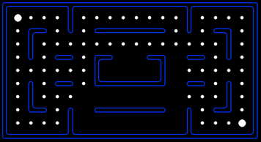

Localization demo
Percept
Action
Percept
Action
Percept
Action
Percept

Slide 15
Localization demo
Percept
Action
Percept
Action
Percept
Action
Percept
SOUTH

Slide 16
Localization demo
Percept
Action
Percept
Action
Percept
Action
Percept
SOUTH
SOUTH

Slide 17
Localization demo
Percept
Action
Percept
Action
Percept
Action
Percept
SOUTH
SOUTH

Slide 18
Localization demo
Percept
Action
Percept
Action
Percept
Action
Percept

Slide 19
Localization demo
Percept
Action
Percept
Action
Percept
Action
Percept
WEST

Slide 20
Localization demo
Percept
Action
Percept
Action
Percept
Action
Percept
WEST

Slide 21
Localization demo
Percept
Action
Percept
Action
Percept
Action
Percept
WEST
WEST

Slide 22
Localization demo
Percept
Action
Percept
Action
Percept
Action
Percept
WEST
WEST

Slide 23
Localization demo
Percept
Action
Percept
Action
Percept
Action
Percept
WEST
WEST
WEST

Slide 24
Localization demo
Percept
Action
Percept
Action
Percept
Action
Percept
WEST
WEST
WEST

Slide 25

State estimation contd.
Is the eager method enough for accurate state estimation?
No! There can be cases where neither X_{t} nor ¬X_{t} is entailed, and neither Y_{t} nor ¬Y_{t} is entailed, but some constraint, e.g., X_{t} v Y_{t}, is entailed
Exact state estimation is intractable in general

Slide 26
Example: Mapping from a known relative location
Without loss of generality, call the initial location 0,0
The percept tells Pacman which actions work, so he always knows where he is
“Dead reckoning”
Initialize the KB with PacPhysics for T time steps, starting at 0,0
Run the Pacman agent for T time steps
At each time step
Update the KB with previous action and new percept facts
For each wall variable Wall_x,y
If Wall_x,y is entailed, add to KB
If ¬Wall_x,y is entailed, add to KB
Choose an action
The wall variables constitute the map

Slide 27
Mapping demo
Percept
Action
Percept
Action
Percept
Action
Percept
NORTH
EAST
SOUTH

Slide 28
Example: Simultaneous localization and mapping
Often, dead reckoning won’t work in the real world
E.g., sensors just count the number of adjacent walls (0,1,2,3 = 2 bits)
Pacman doesn’t know which actions work, so he’s “lost”
So if he doesn’t know where he is, how does he build a map???
Initialize the KB with PacPhysics for T time steps, starting at 0,0
Run the Pacman agent for T time steps
At each time step
Update the KB with previous action and new percept facts
For each x,y, add either Wall_x,y or ¬Wall_x,y to KB, if entailed
For each x,y, add either At_x,y_t or ¬At_x,y_t to KB, if entailed
Choose an action

Slide 29
Planning as satisfiability
Given a hyper-efficient SAT solver, can we use it to make plans?
Yes, for fully observable, deterministic case:
planning problem is solvable iff there is some satisfying assignment
solution obtained from truth values of action variables
For T = 1 to ∞, set up the KB as follows and run SAT solver:
Initial state, domain constraints
Transition model sentences up to time T
Goal is true at time T
Read off action variables from solution

Slide 30
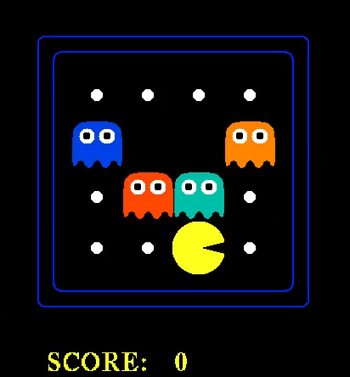

Slide 31
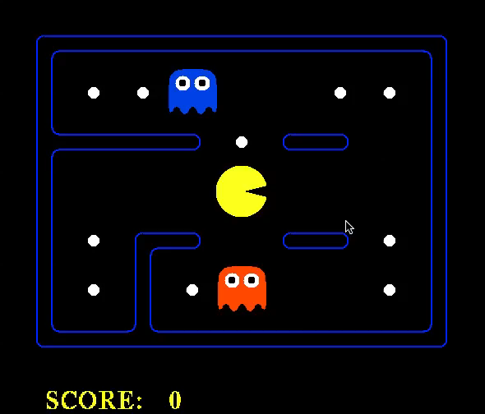

Slide 32
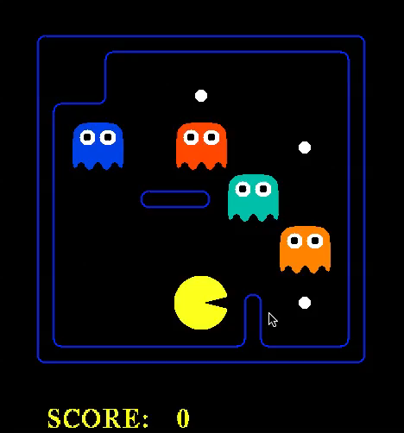

Slide 33
Summary
One possible agent architecture: knowledge + inference
Logics provide a formal way to encode knowledge
A logic is defined by: syntax, set of possible worlds, truth condition
Logical inference computes entailment relations among sentences
SAT solvers based on DPLL provide incredibly efficient inference
Logical agents can do localization, mapping, SLAM, planning (and many other things) just using one generic inference algorithm on one knowledge base

